Slide 1
Mary Shelley’s Frankenstein
Origins and Allusions

Slide 2
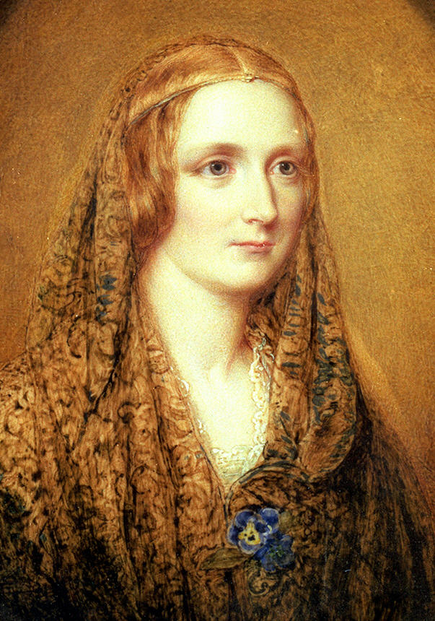
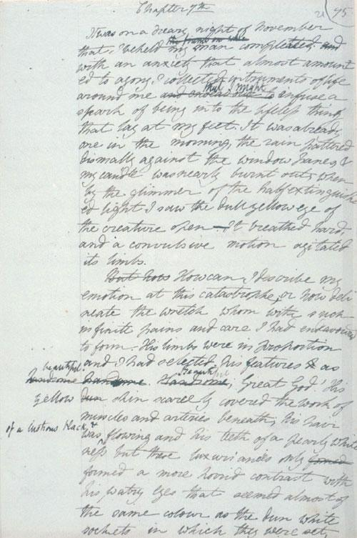
Biography

Slide 3
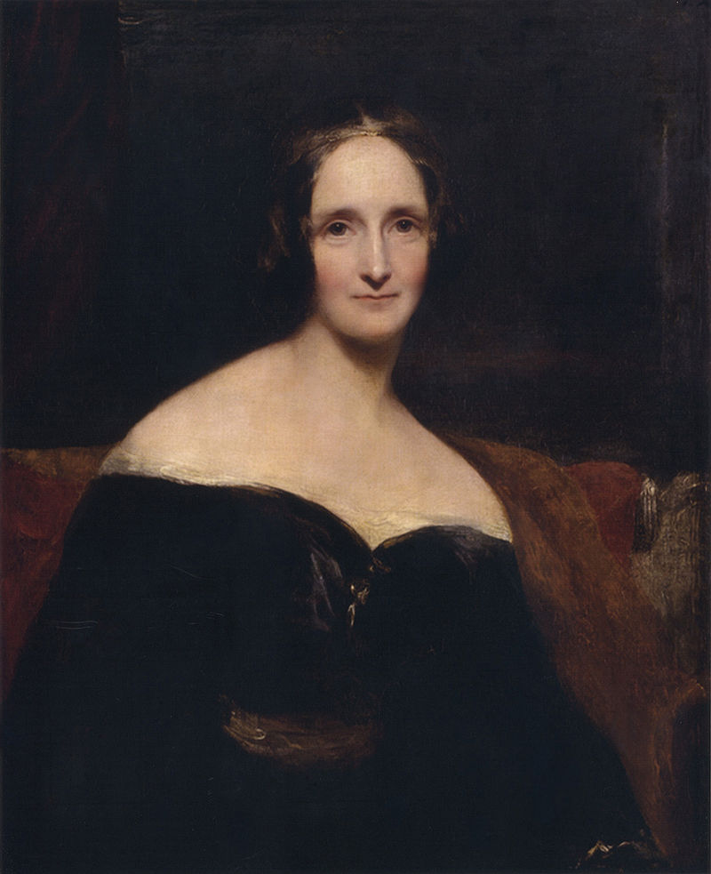
Mary Shelley (1797-1851)
Born Mary Wollstonecraft Godwin
Famous literary and political parents, Mary Wollstonecraft and William Godwin (who led extraordinarily unconventional lives)
Wollstonecraft's 1792 The Vindication of the Rights of Woman is considered one of the earliest works of feminist philosophy; Godwin raised his daughter and educated her informally but with great tutoring and a heavy discipline

Slide 4
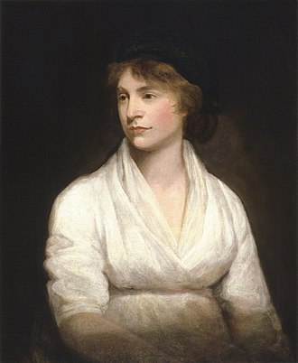
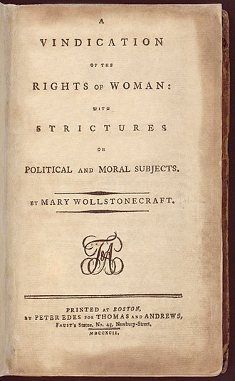
Mary Wollstonecraft: Proto-feminist

Slide 5
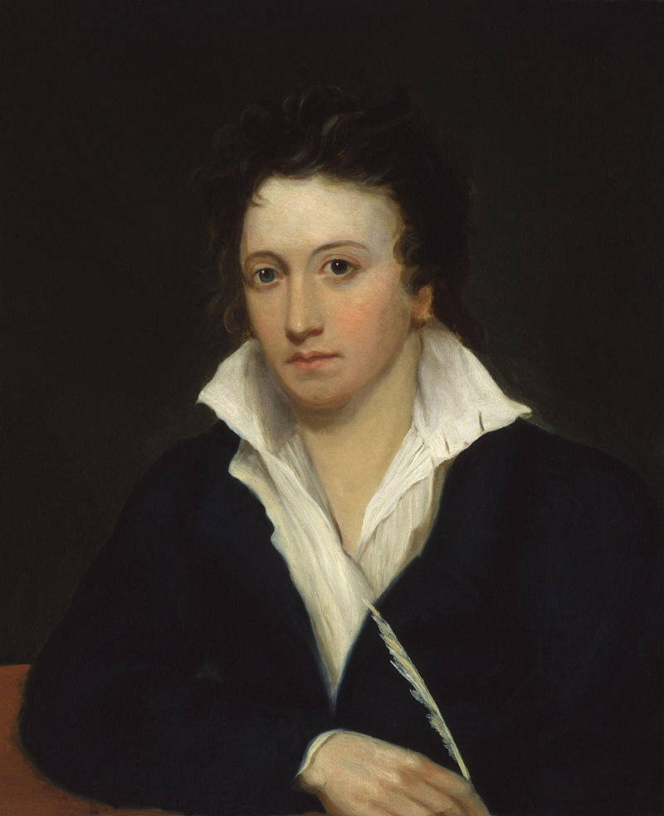
Famous parents, famous husband…
Percy Bysshe Shelley (1792-1822)
Now considered one of the finest English poets of all time
Influential poet of the Romantic period (some famous works includes “Ozymandias”, “Ode to a Skylark”, and Prometheus Unbound (we’ll be reading some of his poems later this semester)

Slide 6
Scandalous Lives
Percy Shelley admired Mary’s father, Godwin, and eventually asked to borrow money from the older man…which he never paid back…
The married Shelley then ran off with Godwin’s young daughter, Mary—his own pregnant wife killed herself, and Mary married Percy in 1816 soon after the body was found…suffice it to say, Mary’s father was not happy with this union
Good friends with poet, Lord Byron (a womanizer called “mad, bad, and dangerous to know”) along with other literati of the Enlightenment period, the Shelley's’ marriage and relationship allowed their writing to flourish
Despite his flaws, Percy Shelley encouraged Mary’s writing

Slide 7
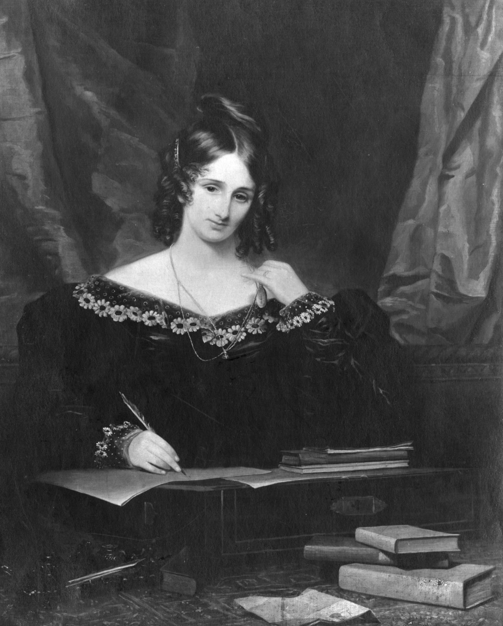
Writer, Wife, Widow…
Mary Shelley endured many hardships throughout her life: her mother died soon after she was born, her husband was unreliable and often in debt, and three of her four children died—their deaths caused serious depression throughout the rest of her life
Percy Shelley drowned at sea when he was just 29 years old
Mary Shelley continued to live by her pen and she wrote in a variety of genres until her death
She lived her remaining years with her only son and his wife--Mary Shelley would die of a brain tumor at age 53

Slide 8
The Birth of Frankenstein
The story behind the novel is almost as interesting as the work itself
Certain factors contributed to her inspiration but we can actually trace the circumstances for it firstly to something relatively mundane…the weather
The eruption of Mount Tambora in Indonesia caused 1816 to be known as “the year without summer” in Europe

Slide 9
Contribution One: Eruption of Mount Tambora
In 1815, Tambora erupted with a rating of seven on the Volcanic Explosivity Index; the largest eruption since the Lake Taupo eruption in 181 AD.^{[7]} The explosion was heard on Sumatra island (more than 2,000 km or 1,200 mi away). Heavy volcanic ash rains were observed as far away as Borneo, Sulawesi, Java and Maluku islands. The death toll was at least 71,000 people, of which 11,000–12,000 were killed directly by the eruption.^{[7]} The eruption created global climate anomalies in the following years. 1816 became known as the Year Without a Summer because of the impact on North American and European weather. In the Northern Hemisphere, agricultural crops failed and livestock died, resulting in the worst famine of the century.^{[7]}

Slide 10
Positive Results of Volcanic Eruptions…
Because the summer was so cold, the Shelleys were forced to spend their holiday inside while vacationing at Lord Byron’s place in Lake Geneva, Switzerland
Lord Byron got bored and proposed the group of friends have a writing competition to see who could write the scariest story…you can guess who won that contest

Slide 11
Contribution Two: A Nightmare
I saw the pale student of unhallowed arts kneeling beside the thing he had put together. I saw the hideous phantasm of a man stretched out, and then, on the working of some powerful engine, show signs of life, and stir with an uneasy, half vital motion. Frightful must it be; for supremely frightful would be the effect of any human endeavour to mock the stupendous mechanism of the Creator of the world—Mary Shelley’s introduction to the 1831 edition
Shelley was trying to think of a good ghost story and had a “waking dream” in the middle of the night, which she has given as a great inspiration for her story

Slide 12
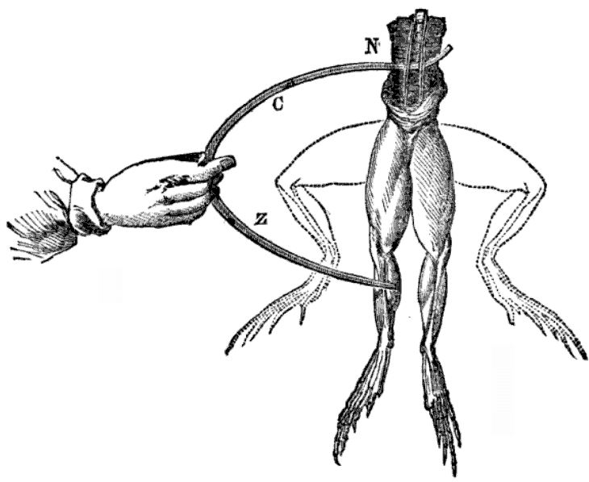
Contribution Three: A Dead Frog
Mary Shelley was interested in a variety of topics and would have known about the recent work done in the sciences
Talking about science was also fashionable at the time; the people involved in the scary story contest were all involved in the sciences in some way
Luigi Galvani discovered that electricity could cause a dead frog’s leg to twitch (1780) He then influenced Wilhelm Ritter’s work (who Shelley references in her Preface to the novel)

Slide 13
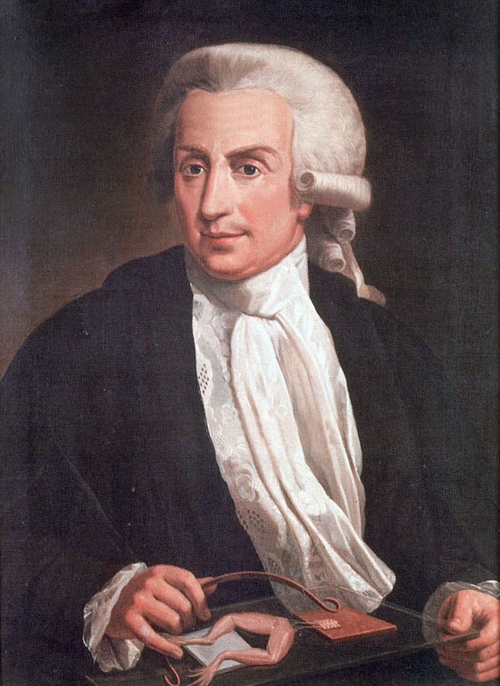
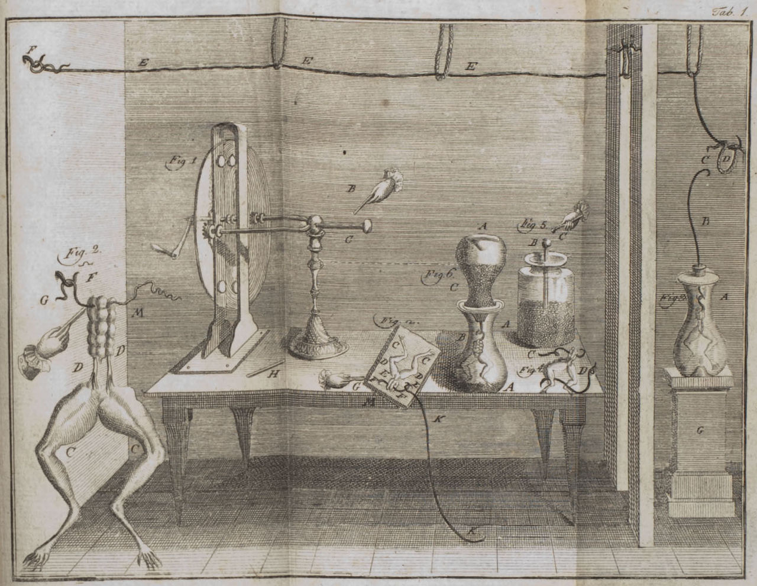
Galvani (1737-1798)

Slide 14
Contribution Four: Mary Shelley’s Unconscious Mind
Though Shelley highlights her dream and her time at Lake Geneva as the major contributors to her inspiration for Frankenstein, it seems that her own psyche was clearly at work: consider the connections between the deaths of her children, her dead mother (and that Mary’s birth indirectly caused that death), Mary’s interests in the sciences, along with her intellectual mind that also fell into depression
Many critics have reflected on Frankenstein as the manifestation of Mary’s deep-rooted fears

Slide 15
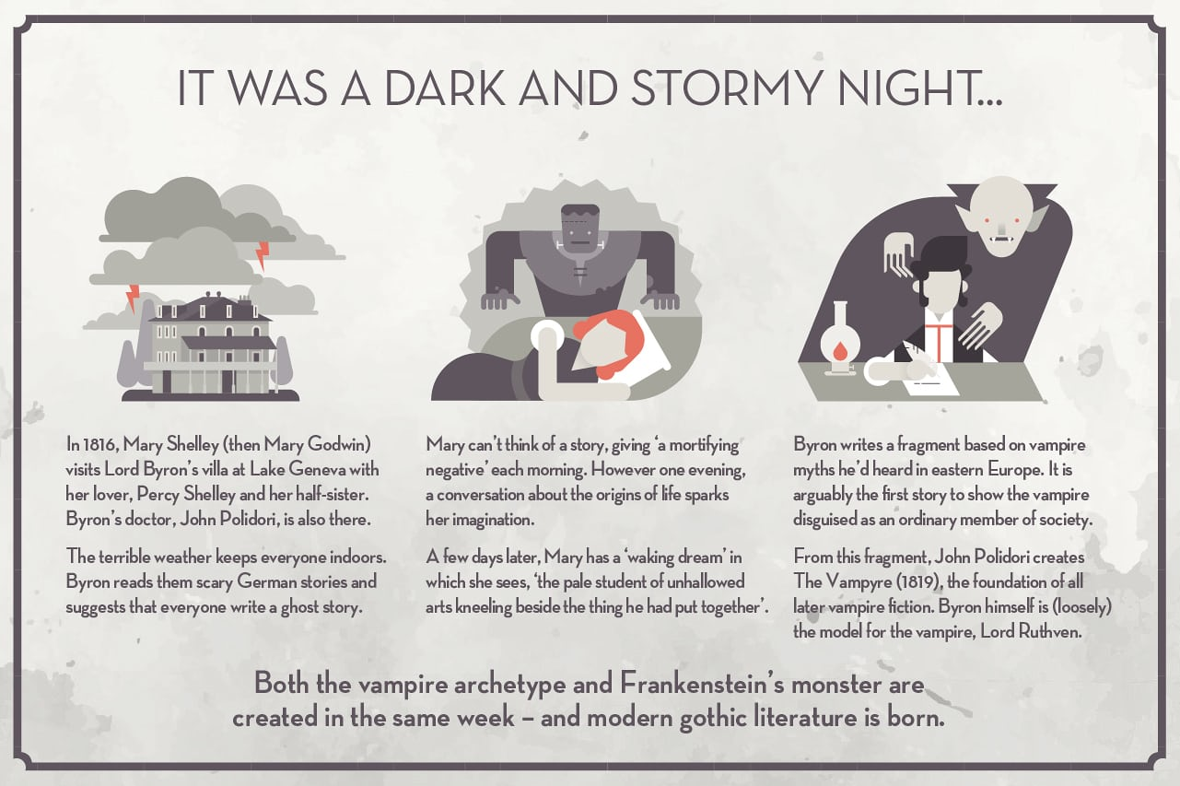

Slide 16
Prometheus
Character in Greek Mythology; Mary Shelley was most likely taught this myth as a child by her own father (who wrote a book on Greek and Roman Myths, The Pantheon) This story was popular in the 19th century and Percy Shelley, Byron, and her own mother, Wollstonecraft, all drew from it for their own work.
TWO Main Versions of the Story of Prometheus: 1. Prometheus steals knowledge from the gods or 2. Prometheus creates a man out of clay and steals life-giving fire to bring his clay-man to life.
In BOTH versions, the gods are not pleased with Prometheus and he is punished.
One of the Titans who were overthrown by their children, the Olympians in “the battle of the Titans”—Prometheus was able to escape punishment in this confrontation but ended up getting in a lot of trouble with Zeus, the king of the Olympic Greek gods…
Reputation as a trickster god, he decided to mock Zeus—most notably by introducing fire to humans
Zeus had refused fire to humans and Prometheus snuck behind his back and gave it to them
Zeus punished Prometheus in a terrible way: he was chained to a rock and an eagle would eat his liver during the day. It would grow back in the night and the eagle would come back and eat the liver again. Every day, forever until eventually Hercules saved Prometheus from this torture.

Slide 17
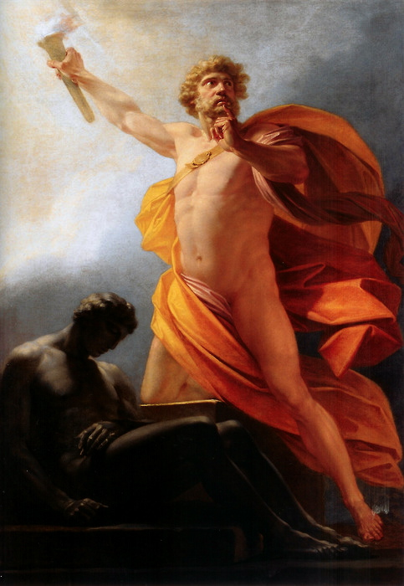

Slide 18
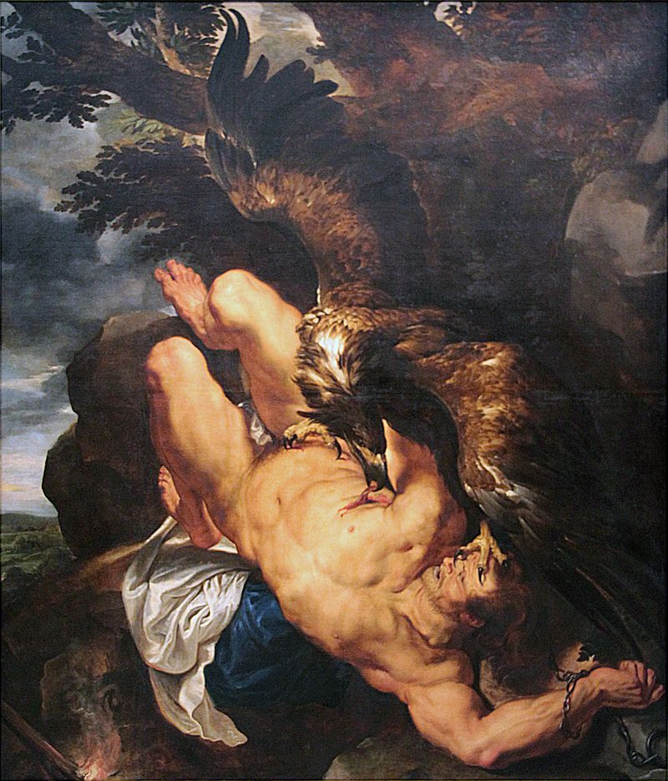

Slide 19
Questions to Consider
Was it wrong for Prometheus to introduce fire to humanity?
Is Prometheus a villain or a hero?
How is Frankenstein a “modern Prometheus”?

Slide 20
Frankenstein: Volume One
What is the meanings of the subtitle, “The Modern Prometheus”?
What subtitle would you give this novel?

Slide 21
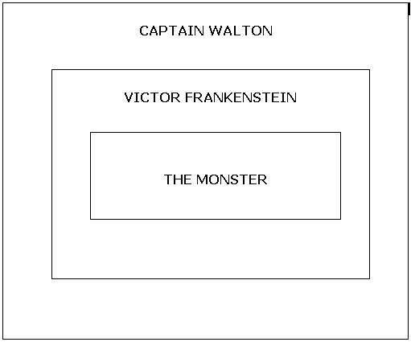
The Frame Narrative

Slide 22
Technique of Frame Narration
What does this framing device do for your experience as a reader?
What does it remind you of and could you think of how it could work with (or in) our current technology?
Or, as a past student Leanna asked: Frankenstein ascribed the horrible result to the knowledge and advised the adventurer not to pursue new things. Does the author aim to say that knowledge is miserable for human?

Slide 23
Quiz
1. Who is blamed for the death of William? Justine
2. Where does Captain Walton want to explore? North Pole
3. Who begins to tell his story to Captain Walton? Victor Frankenstein
4. Who dies of scarlet fever? Frankenstein’s mother
Extra Credit: In what month does Frankenstein behold the “accomplishment” of his “toils”? November
Extra Credit: Who is Victor’s best friend? Henry Clerval

Slide 24
Next Week
Next week, we’ll discuss Volume II along with further discussion of Victor’s education in college from Volume 1 (and…the “monster’s” side of things.)
We’ll also discuss Gothic Fiction and Science Fiction
Focus on drafting your first response papers and meeting with our TAs if you’d like extra help

